Slide 1
Team Ink3D Status 10/18/13
Daniel Lain
Tim Edmonson
Shawn Simonson
Jesse Bowles

Slide 2
Project Plan
Major deliverables broken down versions
Version broken down to discrete sections
Each Version given team Review per section
Update plan via weekly status reports

Slide 3
Project Plan
Task Number | Task Name | Planned Start | Actual Start | Planned Finish | Actual Finish | Planned Work Hours | Actual Work Hours
1 | Senior Design 1 | Wed 9/11/13 | Wed 9/11/13 | Wed 12/11/13 | NA | 227 | 67.5
1.1 | Documents | Wed 9/11/13 | Wed 9/11/13 | Wed 12/11/13 | NA | 227 | 67.5
1.1.1 | System Requirements Specification | Wed 9/11/13 | Wed 9/11/13 | Fri 11/8/13 | NA | 88 | 45.5
1.1.1.1 | Version 1.0 | Wed 9/11/13 | Wed 9/11/13 | Wed 10/9/13 | NA | 57 | 45.5
1.1.1.2 | Version 2.0 | Wed 10/9/13 | Wed 10/9/13 | Fri 11/8/13 | NA | 31 | 0
1.1.2 | Team Charter | Thu 10/10/13 | Thu 10/10/13 | Wed 12/4/13 | NA | 74 | 22
1.1.2.1 | Version 1.0 | Thu 10/10/13 | Thu 10/10/13 | Thu 10/17/13 | NA | 44 | 22
1.1.2.2 | Version 2.0 | Thu 10/17/13 | NA | Wed 12/4/13 | NA | 30 | 0
1.1.3 | Architecture Design Specification | Fri 11/1/13 | NA | Wed 12/11/13 | NA | 65 | 0
1.1.3.1 | Version 1.0 | Fri 11/1/13 | NA | Mon 12/2/13 | NA | 35 | 0
1.1.3.2 | Version 2.0 | Tue 12/3/13 | NA | Wed 12/11/13 | NA | 30 | 0
2 | Senior Design 2 | Wed 1/15/14 | NA | Fri 5/23/14 | NA | 261 | 0
2.1 | Documents | Wed 1/15/14 | NA | Fri 5/23/14 | NA | 111 | 0
2.1.1 | Detailed Design Documnetation | Wed 1/15/14 | NA | Tue 2/18/14 | NA | 71 | 0
2.1.1.1 | Version 1.0 | Wed 1/15/14 | NA | Wed 2/12/14 | NA | 36 | 0
2.1.1.2 | Version 2.0 | Wed 2/12/14 | NA | Tue 2/18/14 | NA | 35 | 0
2.1.2 | Test Plan |  | NA |  | NA | 40 | 0
2.2 | Prototype Implementation | Tue 2/18/14 | NA | Thu 5/15/14 | NA | 150 | 0
2.2.1 | Version 1.0 | Tue 2/18/14 | NA | Tue 3/18/14 | NA | 50 | 0
2.2.2 | Version 2.0 | Tue 3/18/14 | NA | Fri 4/18/14 | NA | 50 | 0
2.2.3 | Final Product | Fri 4/18/14 | NA | Thu 5/15/14 | NA | 50 | 0
3 | Presentations | Fri 9/13/13 | NA | Wed 12/11/13 | NA | 28 | 2
3.1 | SRS Gate Review | Wed 10/9/13 | NA | Fri 11/8/13 | NA | 7 | 0
3.2 | Charter and Plan Review | Wed 10/16/13 | NA | Wed 12/4/13 | NA | 7 | 0
3.3 | Architecture Design Review | Mon 12/2/13 | NA | Wed 12/11/13 | NA | 7 | 0
3.4 | Team Status Report SD 1 | Fri 9/13/13 | NA | Fri 12/6/13 | NA | 7 | 2
4 | Team Meetings | Tue 9/10/13 | Tue 9/10/13 | Tue 12/3/13 | NA | 52 | 18
4.1 | Team Meeting SD1 | Tue 9/10/13 | Tue 9/10/13 | Tue 12/3/13 | NA | 52 | 18
5 | Sponser Meetings |  | NA |  | NA | 0 | 0
6 | MS Project | Sun 9/29/13 | Sun 9/29/13 | Fri 1/10/14 | NA | 40 | 6
6.1 | SD 1 | Sun 9/29/13 | Sun 9/29/13 | Wed 12/4/13 | NA | 20 | 6
6.2 | SD 2 | Fri 1/10/14 | NA | Fri 1/10/14 | NA | 20 | 0

Slide 4
Requirements – Hardware
Rep-Rap Rumba – Control Interface
Cross Team Role
Host vs. Intermediate
Polymerization Requirement

Slide 5
Requirements – Process Flow
CNC Learning
Code Process
Stream Interface
Feedback Loop

Slide 6
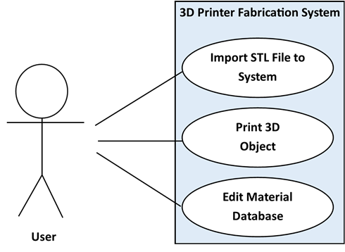
Requirements
Use Cases
Import STL File
Print 3D Object
Edit Material Database
Picture of Success
4 Critical at High Risk
3.14 Slicing Geometry into Thickness Levels 3.11 Creating Printing Paths 3.3 Generating Machine Instructions 3.4 Issuing Machine Instructions

